Slide 1
Week 5 Prototyping
DESN2000 SENG Workshop
SENG, T2 2026

Slide 2
Overview – Prototyping
2 hour workshop
Intro
Prototyping
Group Work – preparation for Interim Report submission – user stories/acceptance criteria and Preliminary Prototype
Intro | Prototyping | Group Work | Wrap-up
5 min | 50 min | 50 min | 5 min
all | all | group | all

Slide 3
Overview – Why are we here today?
What you’ll aim for
At the end of the workshop you should understand:
How to choose the right fidelity for the stage of the design process you are at
Basics of low-fidelity prototyping

Slide 4
Prototyping
50 minutes
The fidelity of the prototype can be broken down into three components: visual, content and functional. There is a huge range for each of these that determines the final fidelity of the overall prototype
The higher the fidelity, the closer the prototype is to how the real product will look/feel
When should you go for a lower fidelity prototype and when should you consider moving towards higher fidelity?
Intro | Prototyping | Group Work | Wrap-up
5 min | 50 min | 50 min | 5 min
all | all | group | all

Slide 5
Prototyping
50 minutes
Think back to the user stories and user story mapping that you have conducted over the last two weeks of workshops (in the context of a streaming interface)
Choose some of those user stories to write your acceptance criteria with, and then supplement this with some low-fidelity prototypes – you can sketch, use Figma or another tool to create LOW-FIDELITY content.

Slide 6
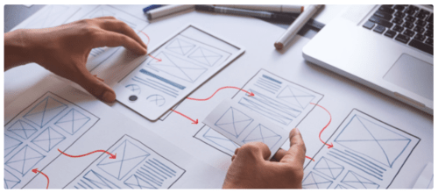
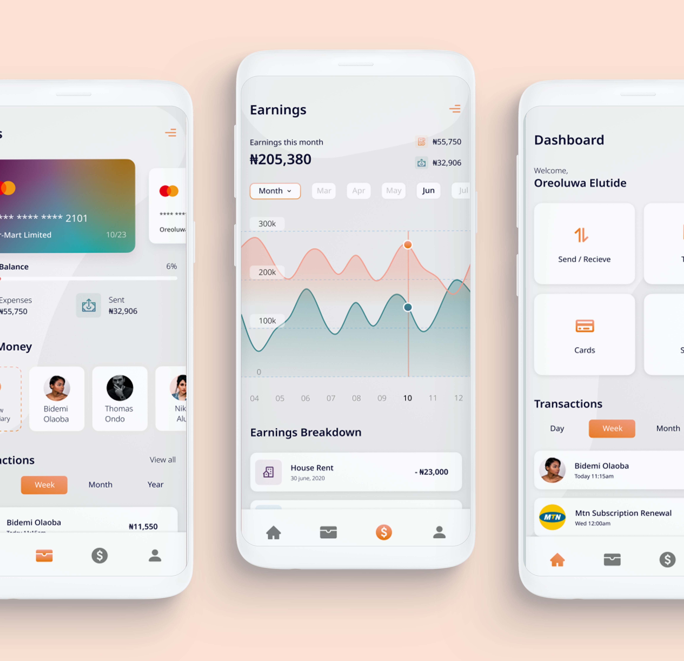
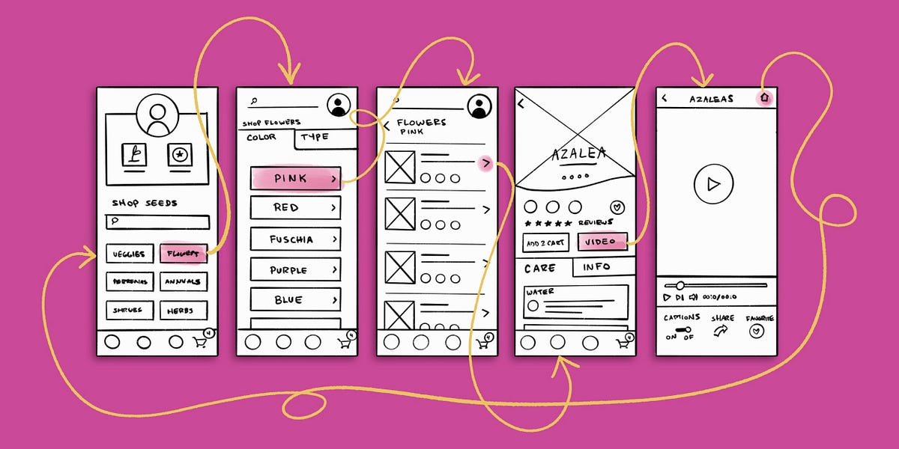
Overview: feasibility and testing in our project stream
Notes:
Reminder from last week’s DESN Workshop. If you didn’t get around to testing a low fidelity prototype based on an Epic, then you might do that today based on one of the examples on the left. If you did then you might use that to start informing your Figma prototype.

Slide 7
Group Work
50 minutes
This is now your group work time where you can work in your group on your project deliverables
What should we be doing?
Continue working on your interim report and preliminary prototype
Your demonstrator will walk around and check in with each group to provide feedback on your progress and answer any questions you may have
Intro | Prototyping | Group Work | Wrap-up
5 min | 50 min | 50 min | 5 min
all | all | group | all
Notes:
In this 50mins, you might finish off putting Epics, User Stories and User Activities into Releases etc. on Jira, or if you have completed that (well done!) then you might be refining your Prelim Report and showing me a copy for recommendations on how to improve. OR if you are confident in that, continue with your Prototypes!

Slide 8
Group Work
50 minutes
Each week we will check in on where we are at with our projects to make sure that everyone is moving towards the same goals.
Week 1
Week 2
Week 3
Week 4
Week 5
Week 6
Week 7
Week 8
Week 9
Week 10
Week 11
Interim Report
Prelim Report
Design Presentation
Final Report
What is my problem?
What about a potential solution?
Test and Iterate
Did you consider accessibility?
Who is my user?
What do my users want?
Envisage the solution
Test and Iterate
User Stories
Document and present
Test and Iterate
Notes:
Leave 5mins for this again, Show them that there is no workshop in Flex Week (Week 6).

Slide 9
Next week – Flex Week
There are no scheduled classes next week, as it is Week 6 – Flexibility Week. We will resume in Week 7 with a workshop focusing on UX/UI and design components.
Have a safe, and restful break!

Slide 10
Wrap
5 minutes
Reflection: Do you think prototype is a useful process to undertake before jumping into development? What questions do you think prototyping can answer in the world of software development?
Intro | Prototyping | Group Work | Wrap-up
5 min | 50 min | 50 min | 5 min
all | all | group | all

